Slide 1


August 10, 2026
CSWB Plan Research
Mavis Morton, University of Guelph
Marlene Ham, OAITH

Slide 2
Community Safety & Policing Act, 2019 - requirement for CSWB Plan:
Comprehensive Ontario Police Services Act, 2019 created the Community Safety and Policing Act, 2019 (CSPA)
Part XVI of the CSPA (Sec. 248) declared that every municipality must prepare and adopt a community safety well-being plan.
Notes:
Marlene
The requirements for municipalities to create Community Safety and Well-Being Plans stem from legislative efforts to promote proactive, collaborative approaches to community safety. In January 2019, new requirements for Community Safety and Well-being (CSWB) planning came into effect. The Police Services Act, 1990 (PSA) was amended, and municipalities across Ontario were instructed to develop and adopt a community safety and well-being plan in partnership with stakeholders and groups that are active in delivering services within our communities.
This requirement mandated that municipalities add additional responses to safety issues that focus on addressing the root causes of societal issues (Government of Ontario, 2019). This legislation ensures that Municipalities are responsible for developing and adopting CSWB plans to prioritize the community’s needs.
Traditionally, public safety focused on responding to incidents through policing and emergency services alone. The CSWB plans to create a strategy which promotes early intervention and prevention to reduce reliance on emergency responses. This means that municipalities must form planning structures such as advisory committees, working groups, or implementation teams to guide the development and execution of their CSWB plans. It also requires the collaboration of a wide range of stakeholders, including police, public health, social services, educators, and community members.
The Ontario Community Safety and Well-Being Planning framework was provided as a guide for municipalities to develop their own plans.

Slide 3
The Act mandates several requirements:
Work in partnership with a multi-sectoral advisory committee comprised of representation from the police service board and other local service providers …
Conduct consultations with the advisory committee and members of the public… community organizations.
Include content such as risk factors, strategies to reduce risk factors, measurable outcomes etc.
Notes:
Marlene
The requirements for municipalities to create Community Safety and Well-Being Plans stem from legislative efforts to promote proactive, collaborative approaches to community safety. In January 2019, new requirements for Community Safety and Well-being (CSWB) planning came into effect. The Police Services Act, 1990 (PSA) was amended, and municipalities across Ontario were instructed to develop and adopt a community safety and well-being plan in partnership with stakeholders and groups that are active in delivering services within our communities.
This requirement mandated that municipalities add additional responses to safety issues that focus on addressing the root causes of societal issues (Government of Ontario, 2019). This legislation ensures that Municipalities are responsible for developing and adopting CSWB plans to prioritize the community’s needs.
Traditionally, public safety focused on responding to incidents through policing and emergency services alone. The CSWB plans to create a strategy which promotes early intervention and prevention to reduce reliance on emergency responses. This means that municipalities must form planning structures such as advisory committees, working groups, or implementation teams to guide the development and execution of their CSWB plans. It also requires the collaboration of a wide range of stakeholders, including police, public health, social services, educators, and community members.
The Ontario Community Safety and Well-Being Planning framework was provided as a guide for municipalities to develop their own plans.

Slide 4
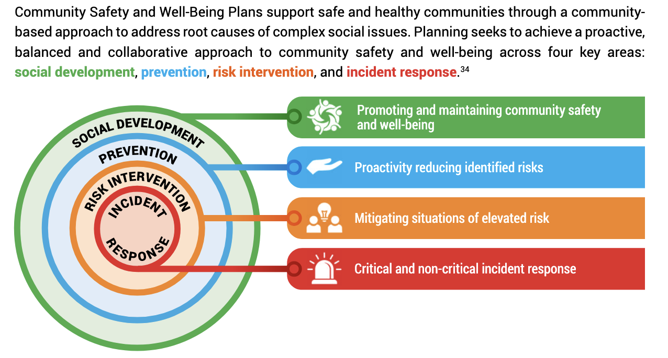
APRIL 28, 2025
The Ministry of Community Safety and Correctional Services developed a community safety and well-being planning framework to guide planning
Notes:
Marlene – this was the common framework municipalities were to address.

Slide 5
Community Safety Well-Being (CSWB) Plan Research
RQ 2: Which Ontario municipalities that have a CSWB Plan, have incorporated GBV/IPV into their plan and what does the structure and process of their plan look like?
Notes:
Marlene -

Slide 6
3 Phases
Phase 1: Fall 2024 – looked for and reviewed plans, started coding
Notes:
Marlene -

Slide 7

APRIL 28, 2025
49- students in a 4th year UofG Violence & Society class
Notes:
Mavis - Community Engaged Teaching and Learning project as part of a Violence and Society Class – one project

Slide 8

CSWB Plan Features Examined
Structural Features
Process Features
Planning Structure
Language
Pillars
Funding
Dedicated Staff
Community Consultation Strategies
IPV Declaration
VAW/GBV Development/Consultation
Implementation Strategy
Notes:
Mavis: We looked at these features based on Marlene’s recommendation
I’m going to briefly go over some of the findings with respect to these features
Next iteration – look more about implementation & evaluation and monitoring

Slide 9
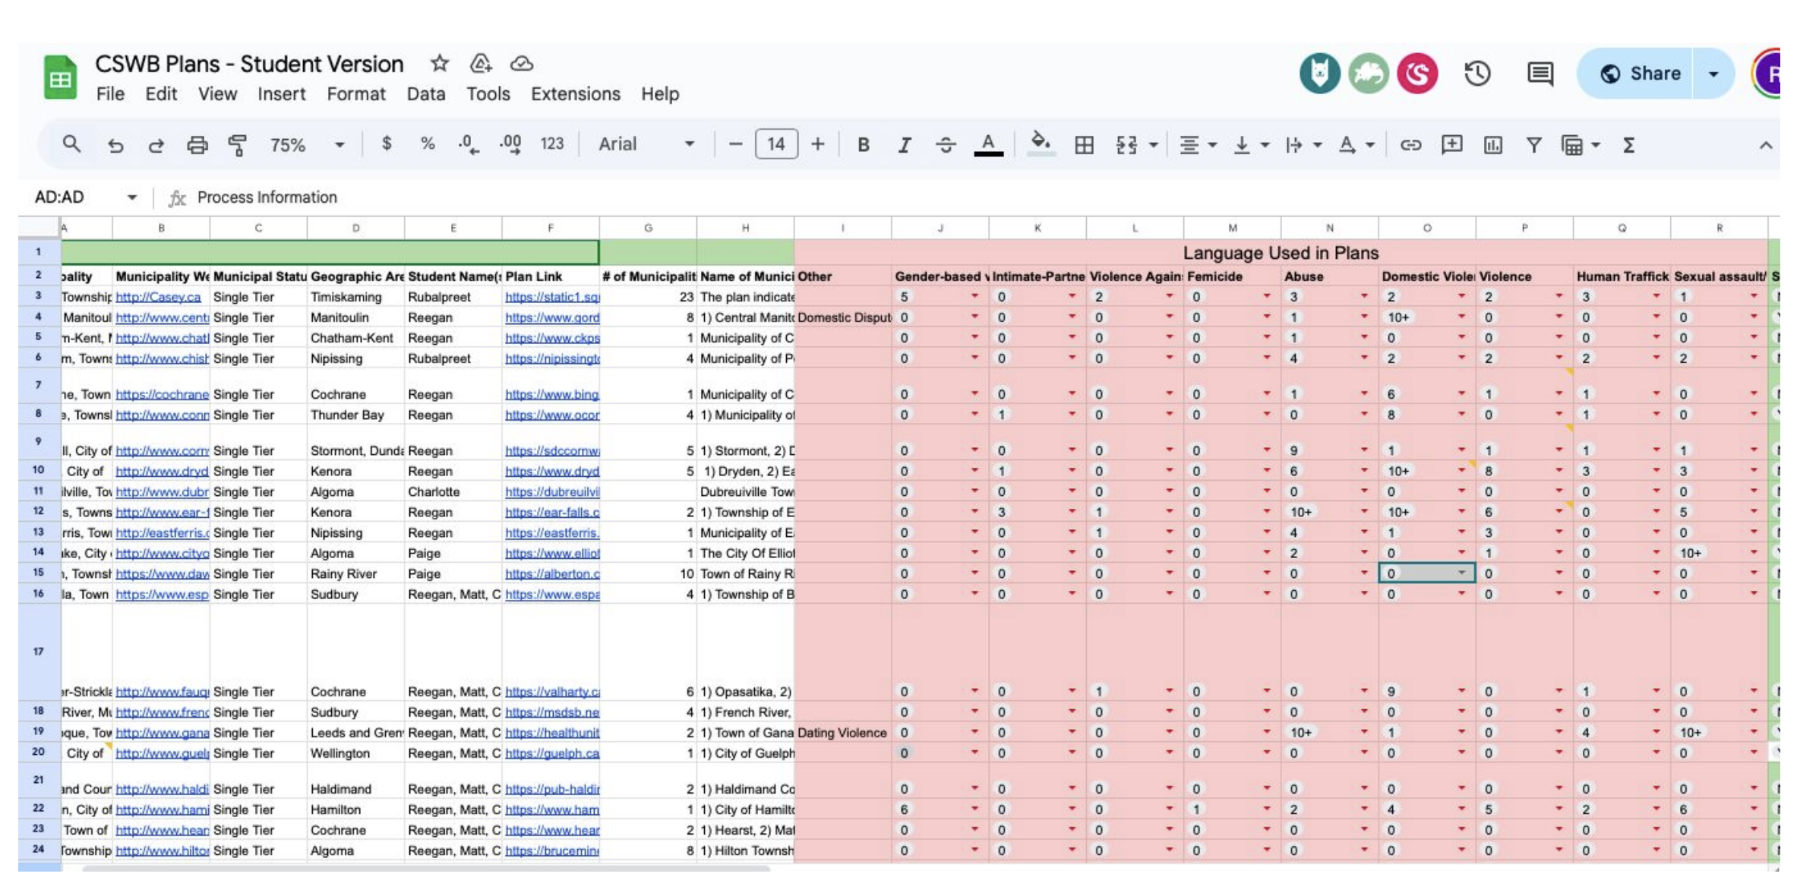
Collaborative Coding via Excel

Slide 10
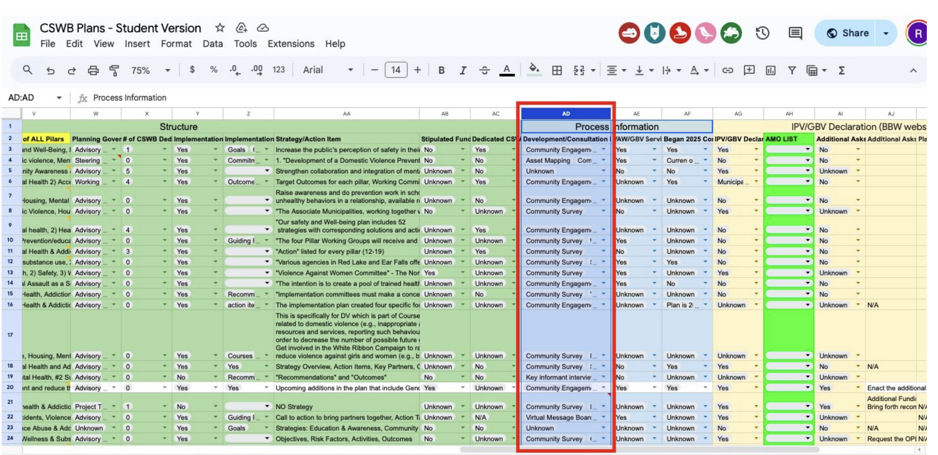
Collaborative Coding via Excel

Slide 11
3 Phases
Phase 2: Fall 2025 – confirmed # of plans that existed, looked form missing plans, reviewed, coded info
Phase 3: May 2026 – compiling results and knowledge mobilization
Notes:
Phase 2: Kendall and Tessa

Slide 12

Notes:
Marlene -

Slide 13
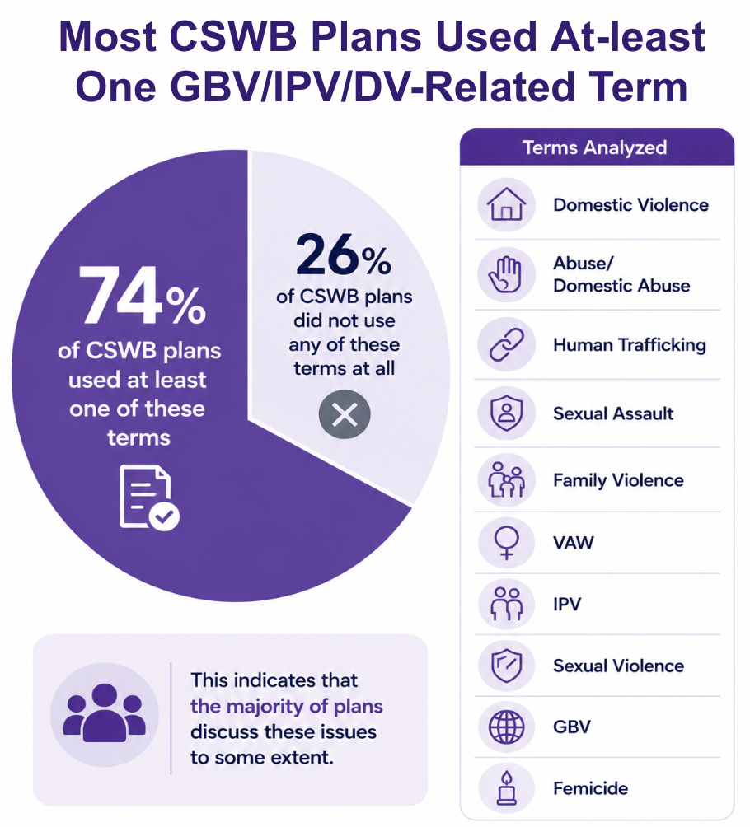
Notes:
Marlene -

Slide 14
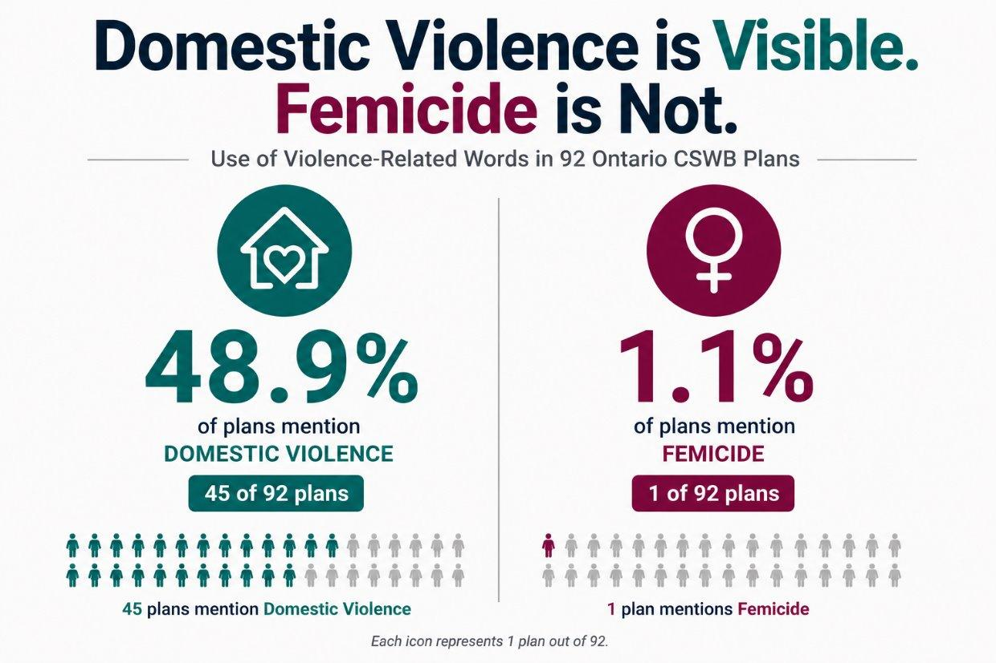
Notes:
Marlene -

Slide 15
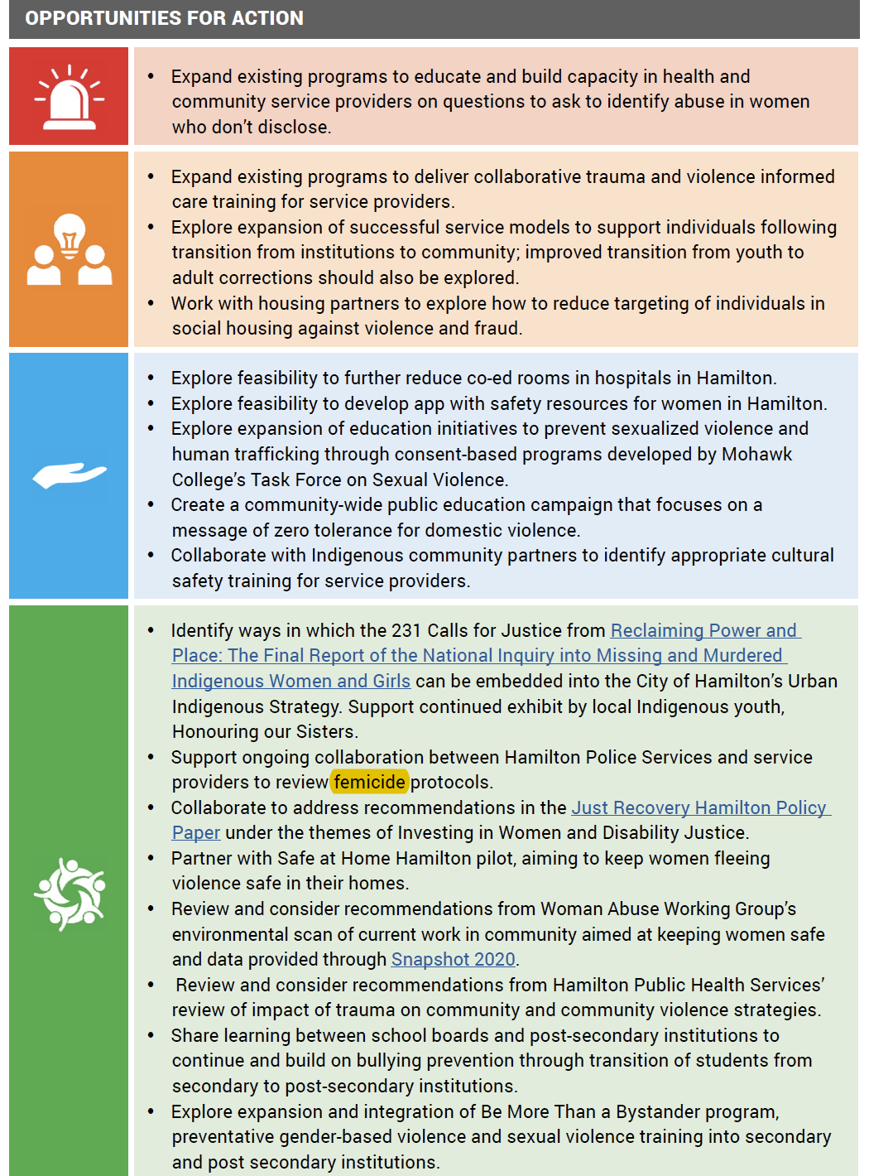
APRIL 28, 2025
Hamilton’s Action Strategy identifies action re: femicide
“Support ongoing collaboration between Hamilton Police Services and service providers to review femicide protocols”

Slide 16
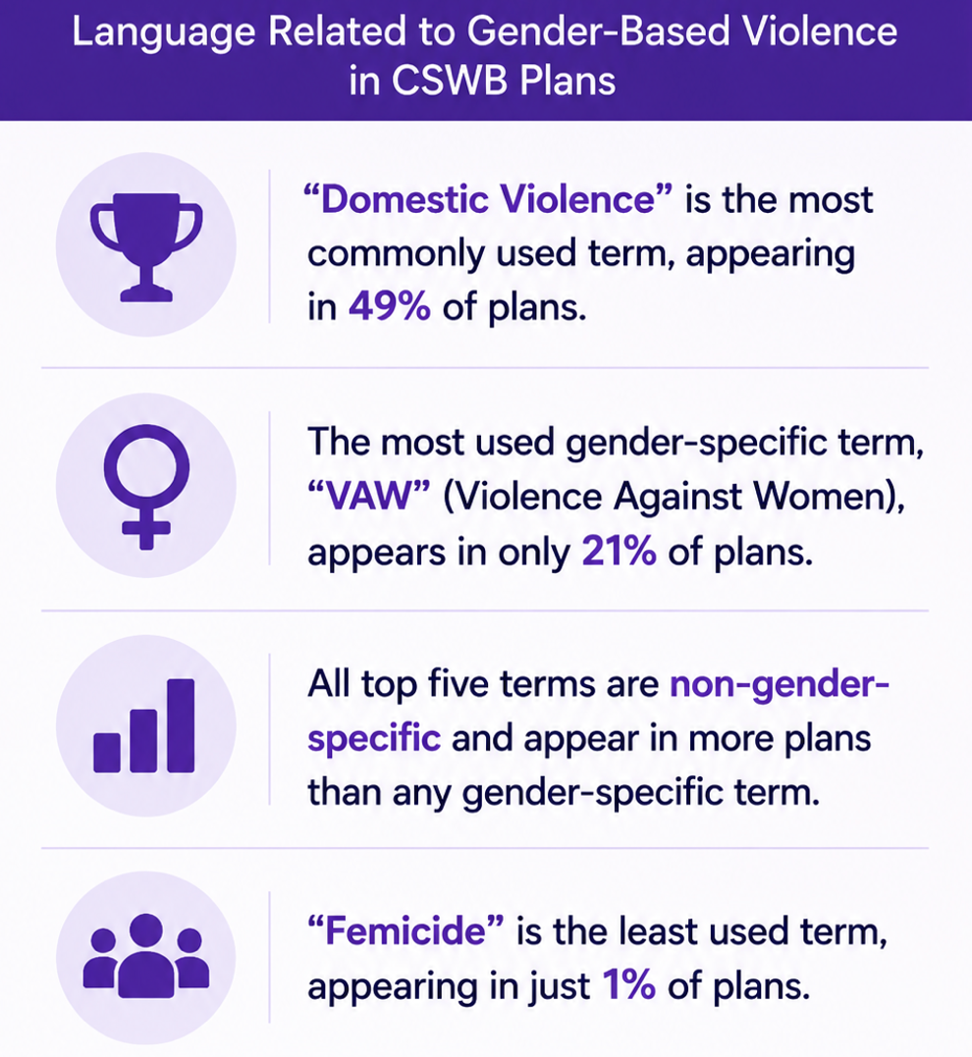
Notes:
Marlene -

Slide 17
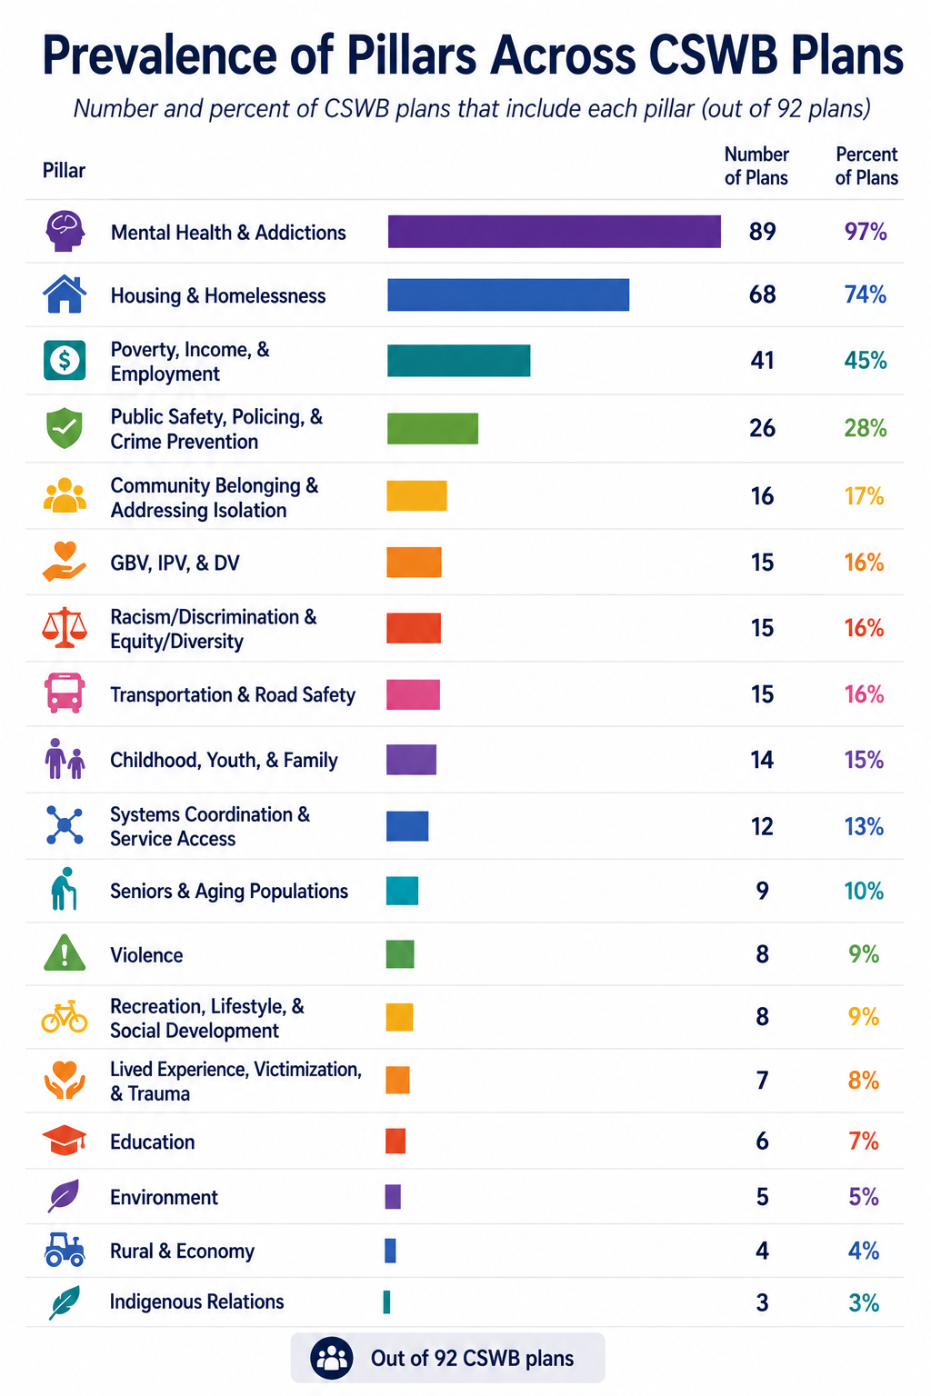
Notes:
Marlene -

Slide 18
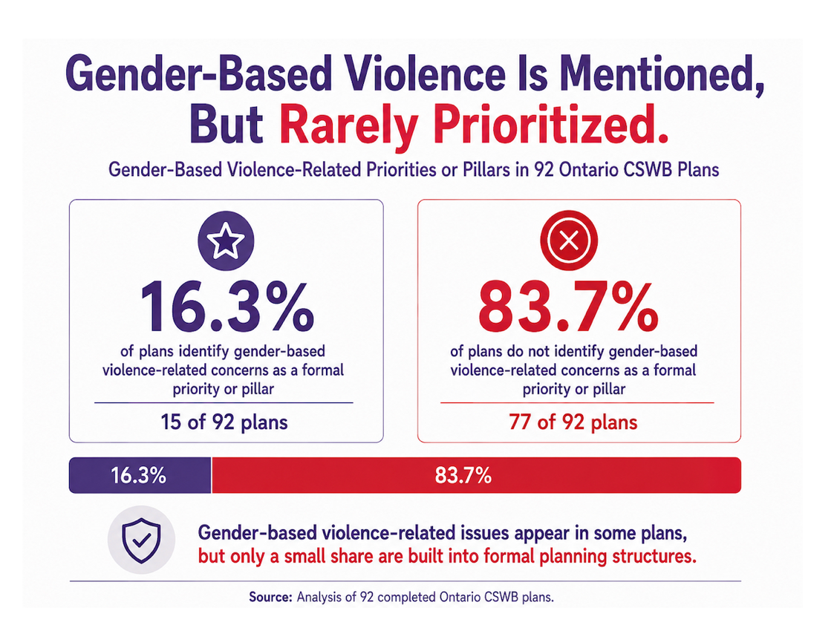
Notes:
Marlene -

Slide 19
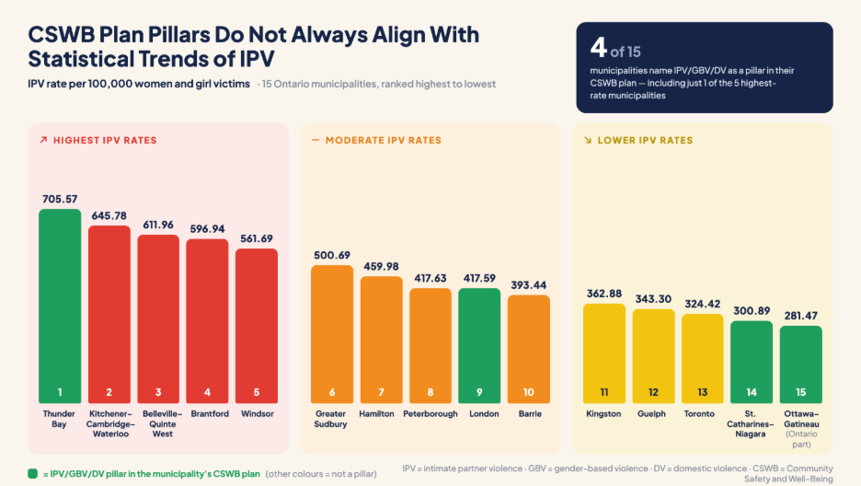
Notes:
Marlene -

Slide 20
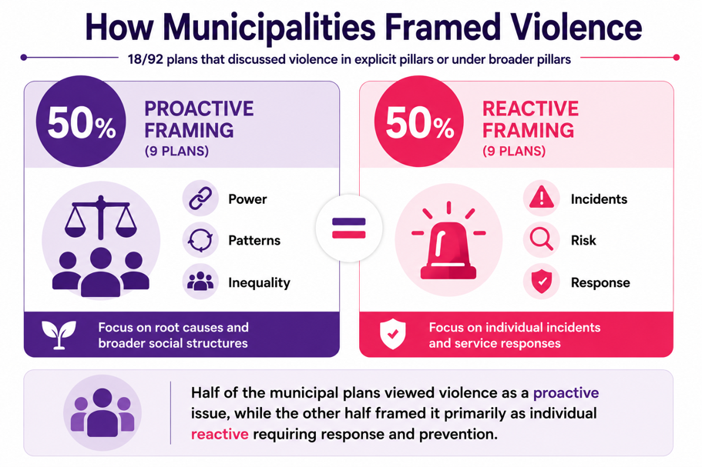
Notes:
Marlene -

Slide 21
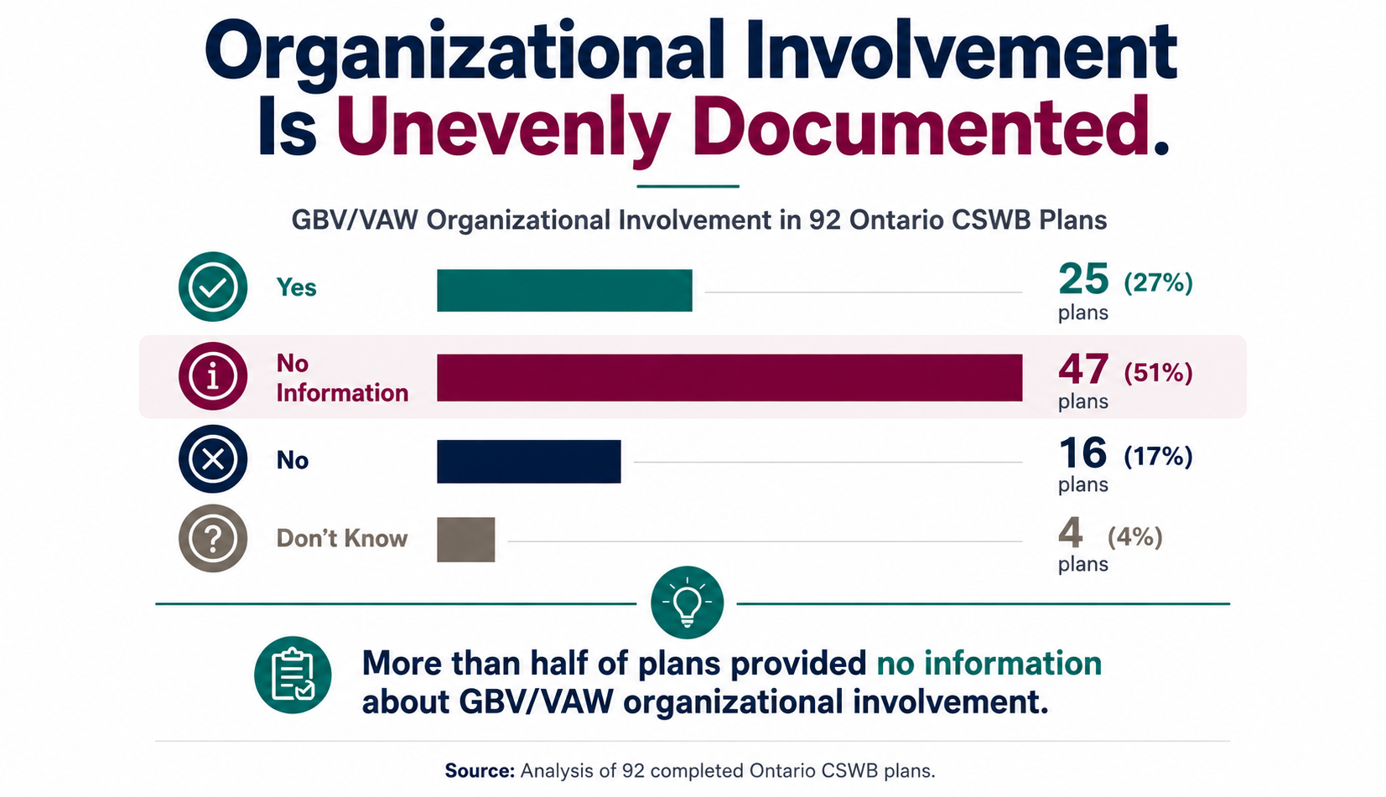
Notes:
Marlene -

Slide 22
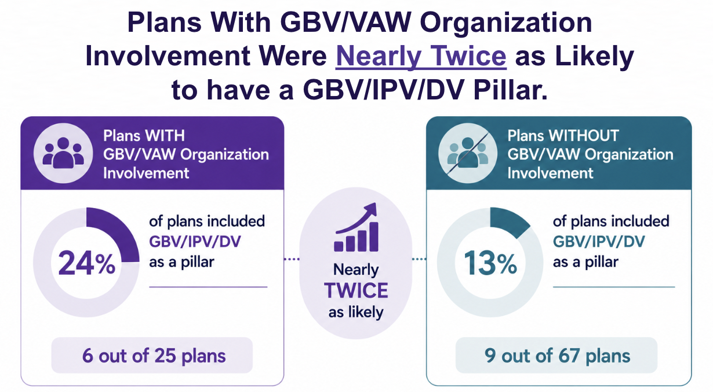
Notes:
Marlene -

Slide 23
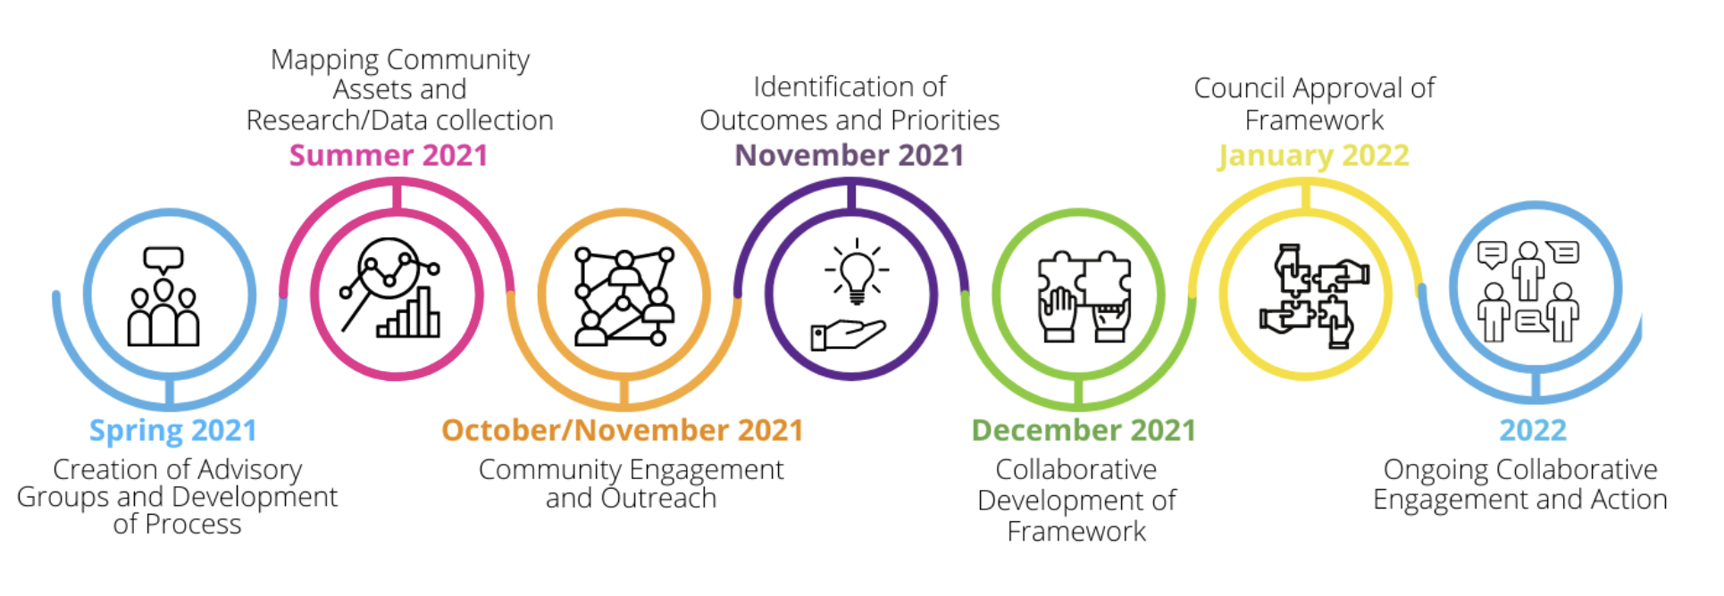
CSWB Plan Process Example (Waterloo)
APRIL 28, 2025
Notes:
Common process included outside research, 2ndary data, primary data gathering from community using various methods, analysis and development of priorities and implementation strategies

Slide 24
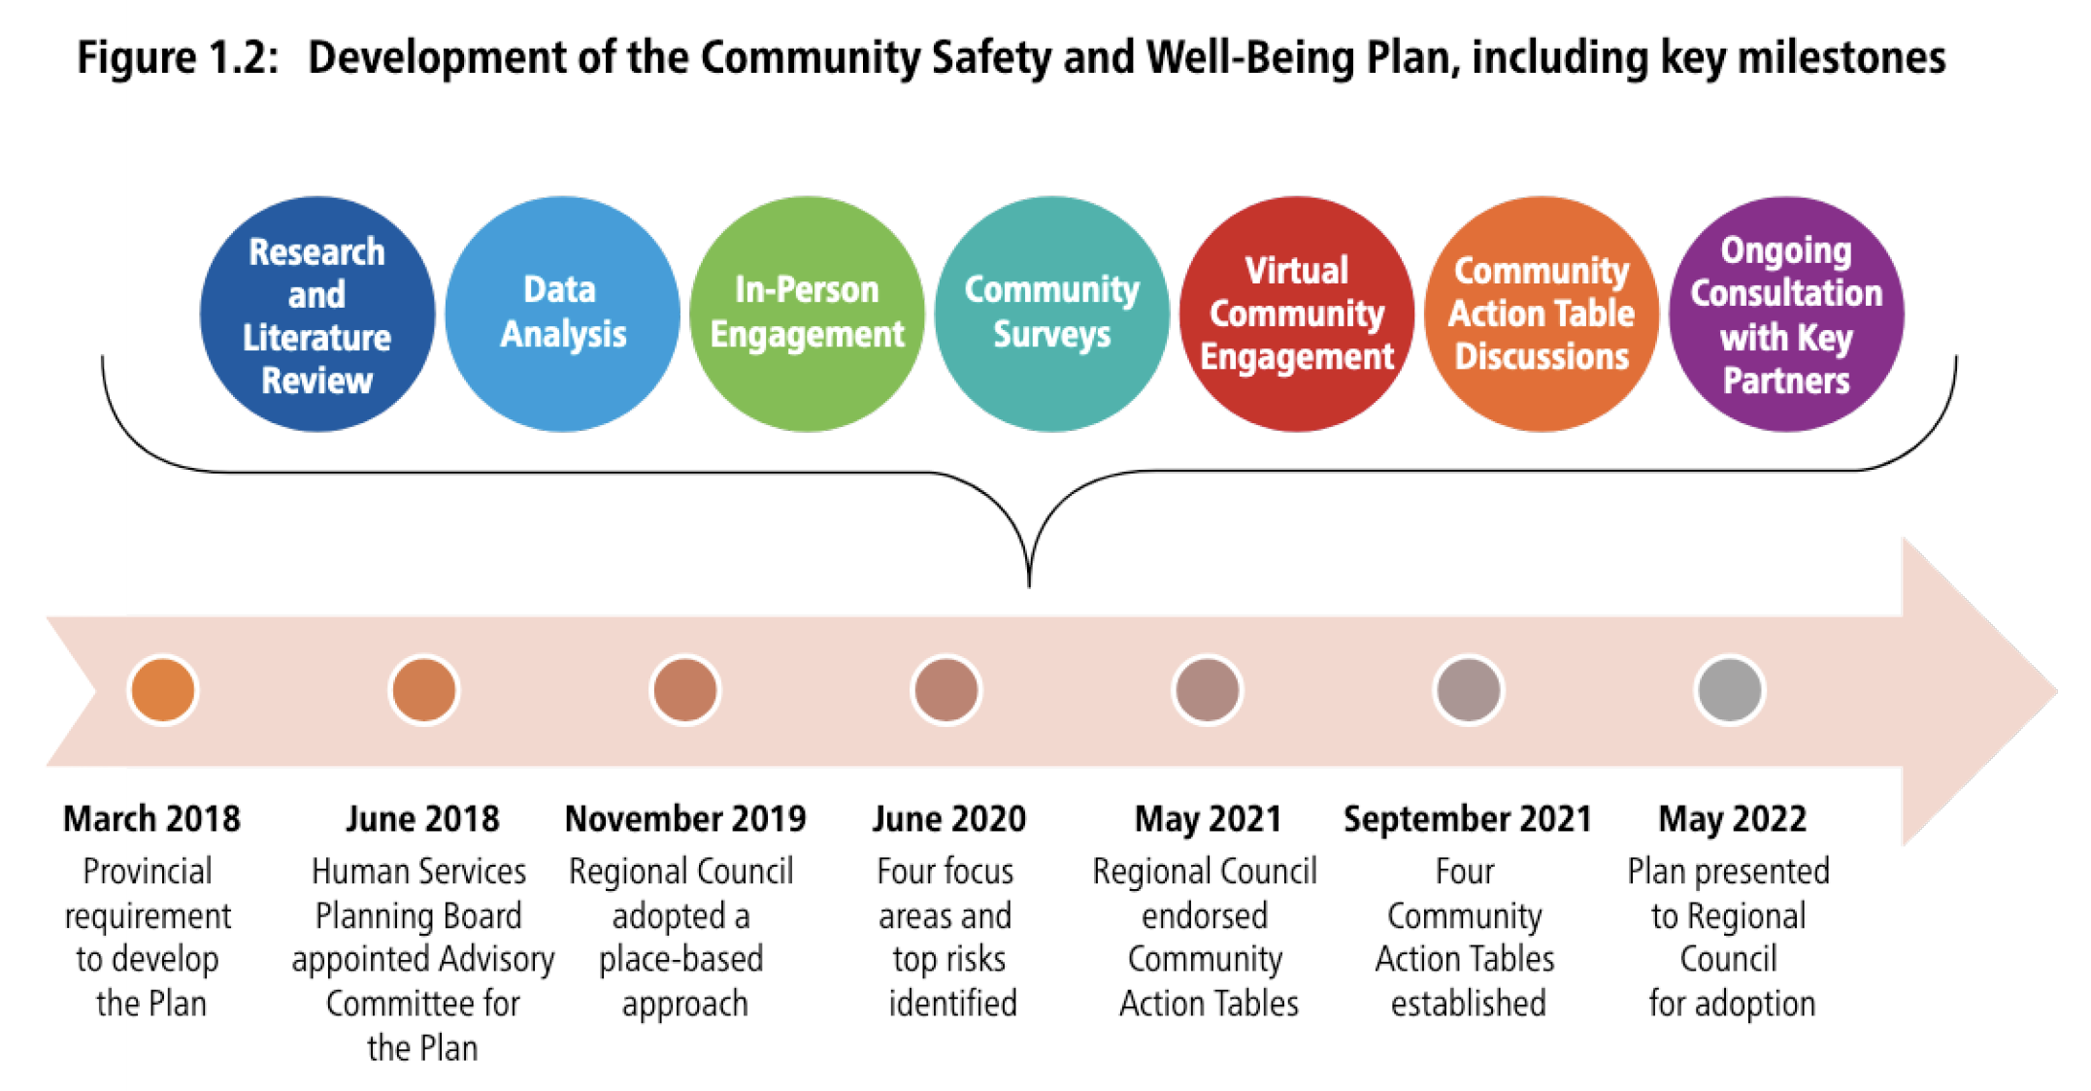
CSWB Plan Process Example (York)
APRIL 28, 2025
Notes:
Common process included outside research, 2ndary data, primary data gathering from community using various methods, analysis and development of priorities and implementation strategies

Slide 25
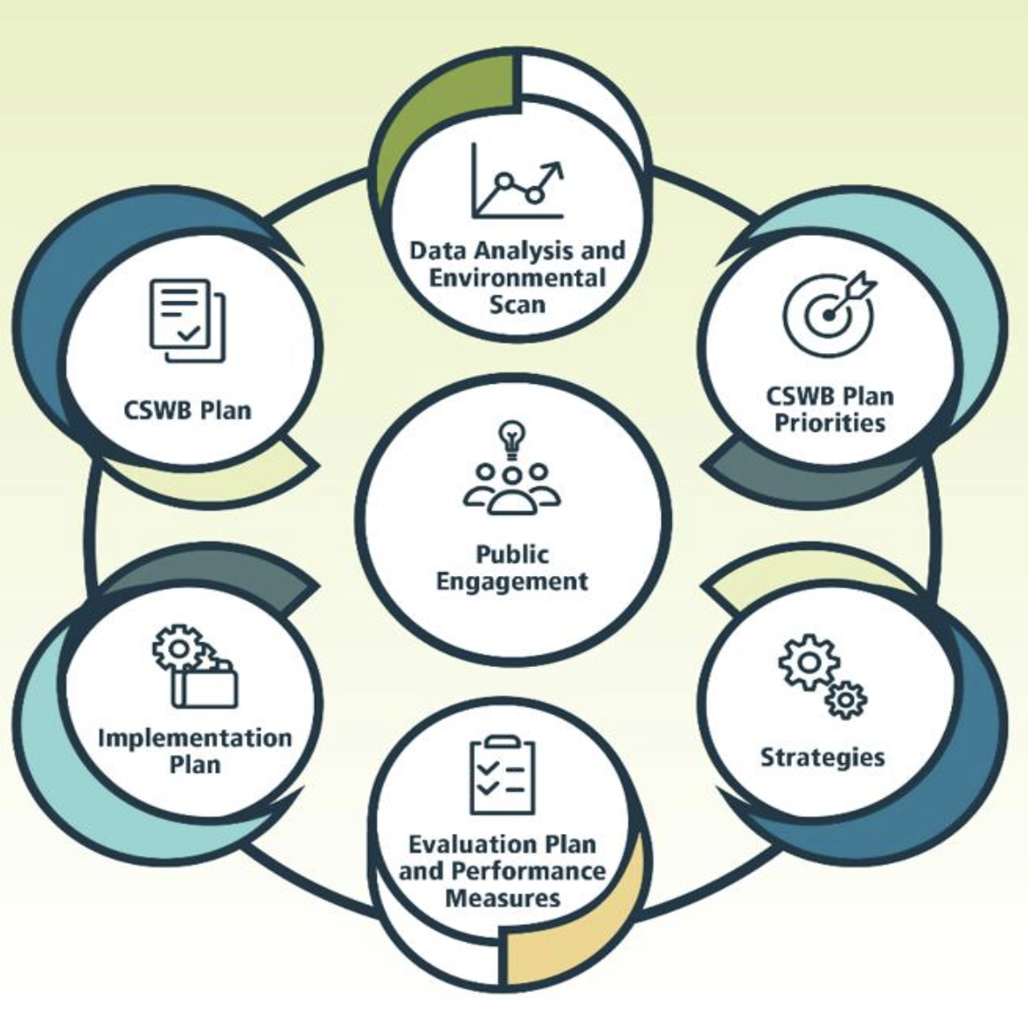
CSWB Plan Process Example (Ottawa)
APRIL 28, 2025
Notes:
Common process included outside research, 2ndary data, primary data gathering from community using various methods, analysis and development of priorities and implementation strategies

Slide 26
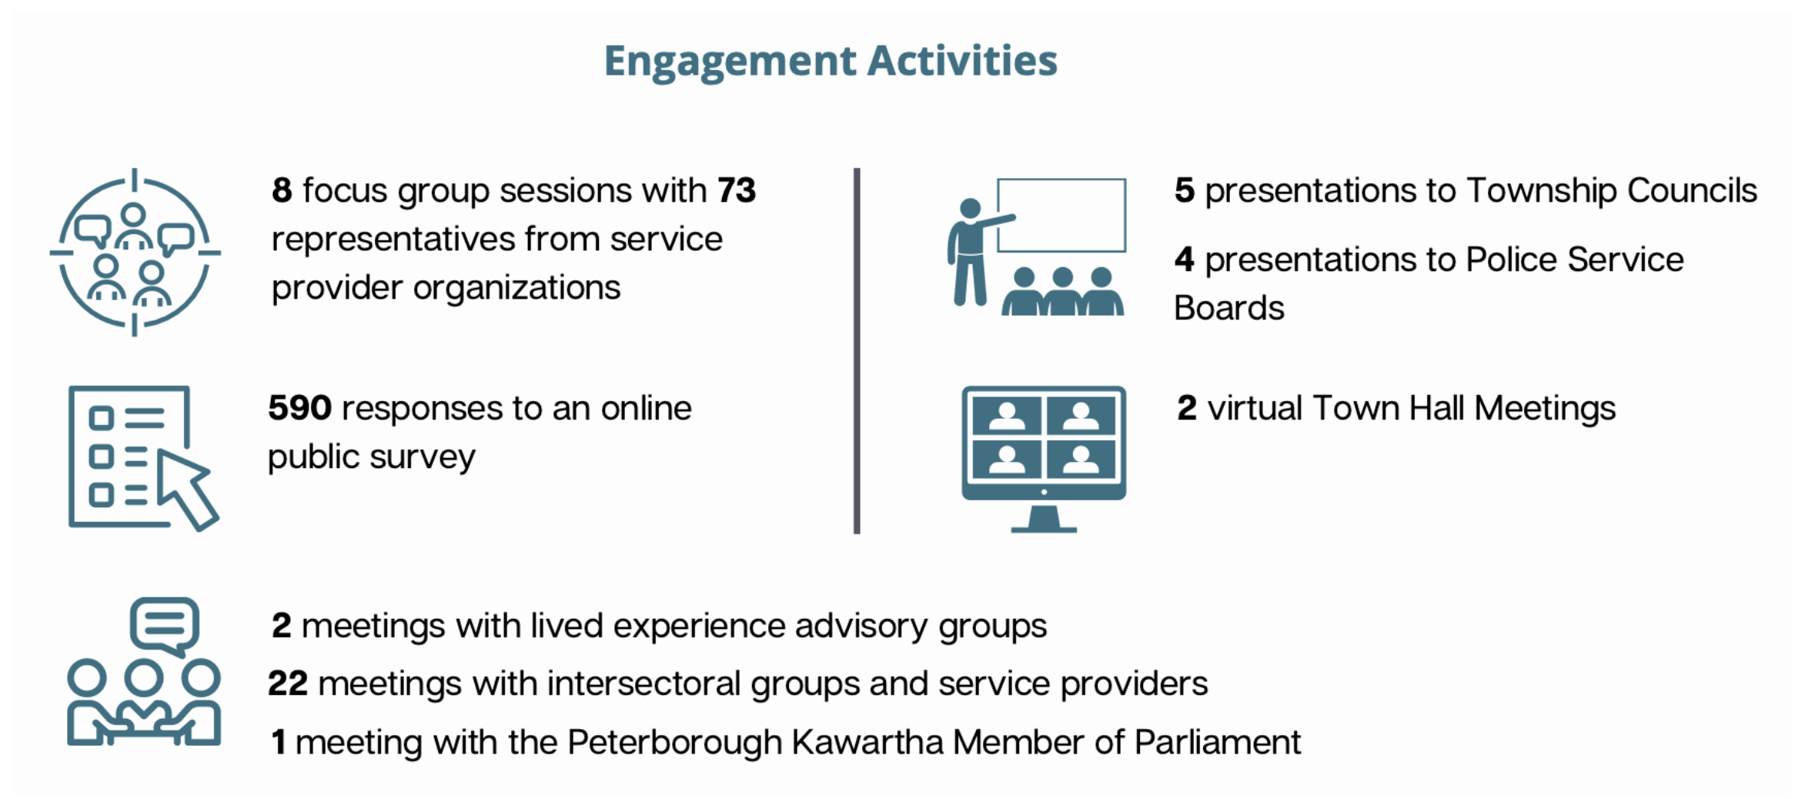
Community Engagement Activities Example (Peterborough)

Slide 27
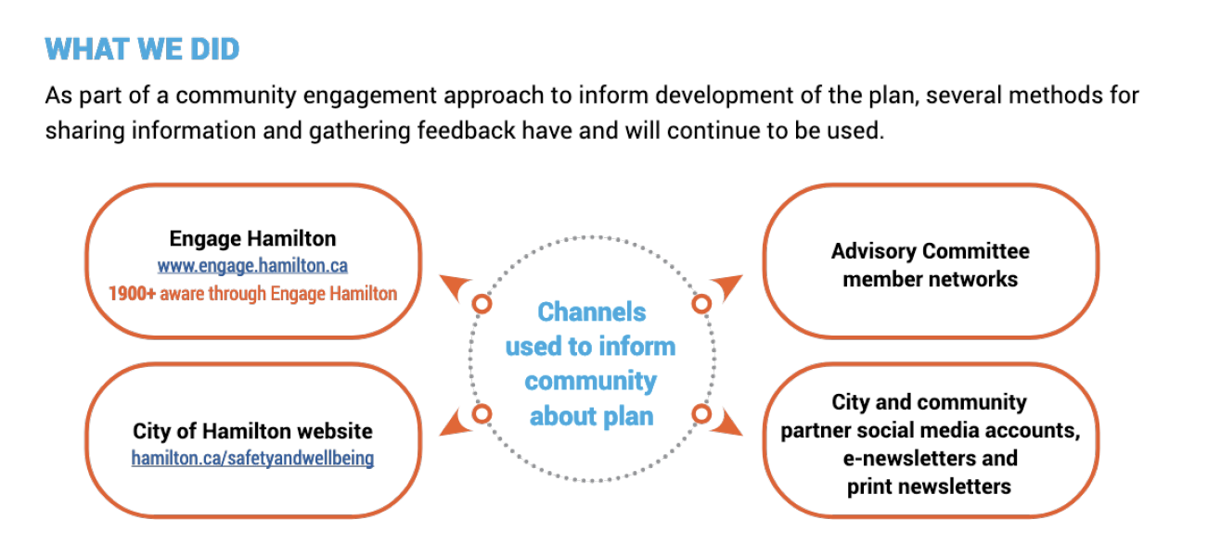
Community Engagement Example (Hamilton)
APRIL 28, 2025

Slide 28
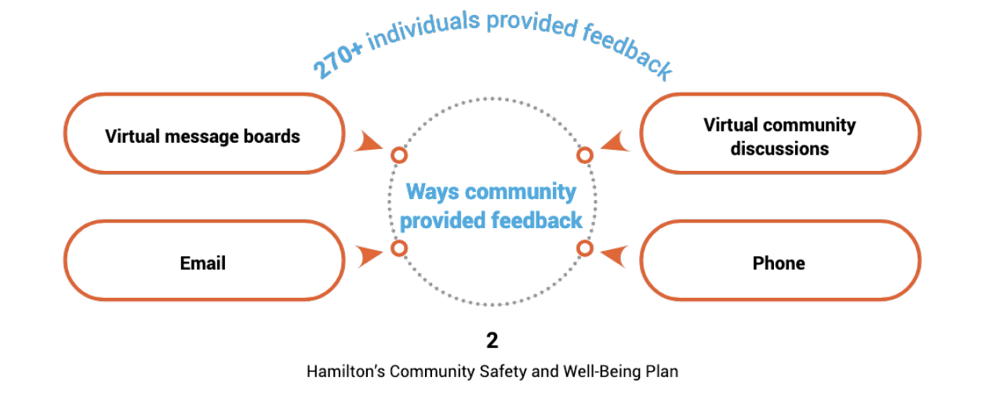
Community Consultation Example
(Hamilton)
Notes:
Mavis – virtual focus

Slide 29
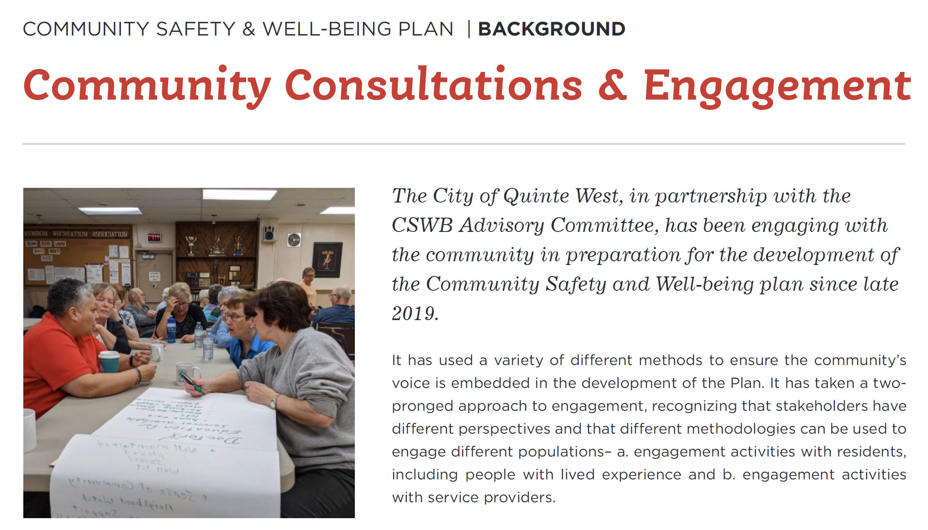
Community Consultation & Engagement Example (Quinte West)
Notes:
Mavis – in person consultations

Slide 30
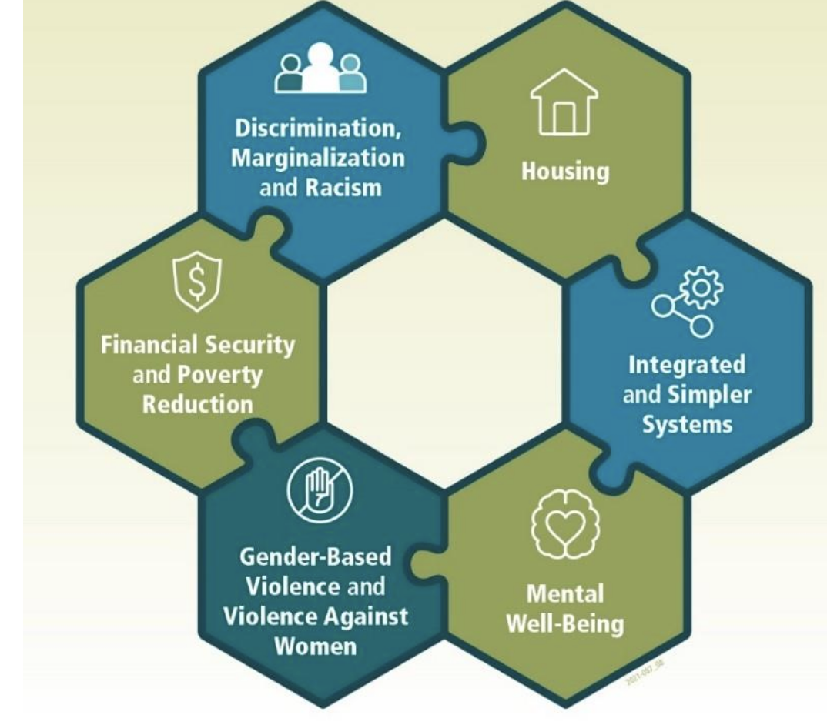

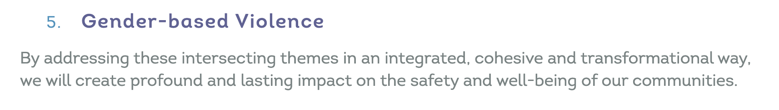
Ottawa
Thunder Bay
Oxford Communities

Slide 31
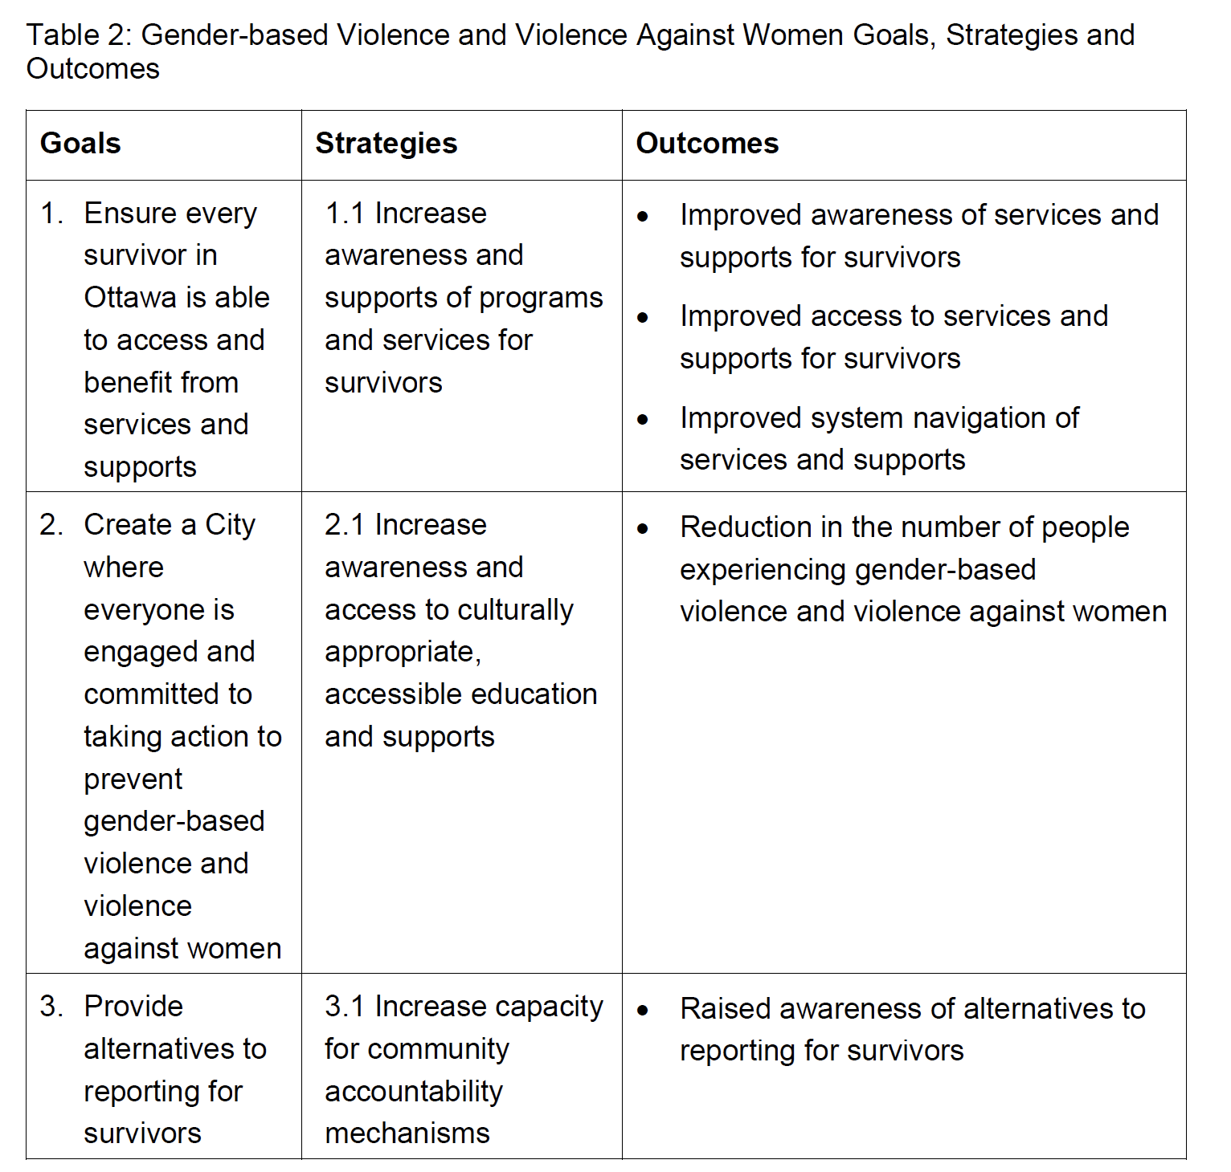
Ottawa
Notes:
Here is what Ottawa’s goals, strategies and outcomes looked like.

Slide 32
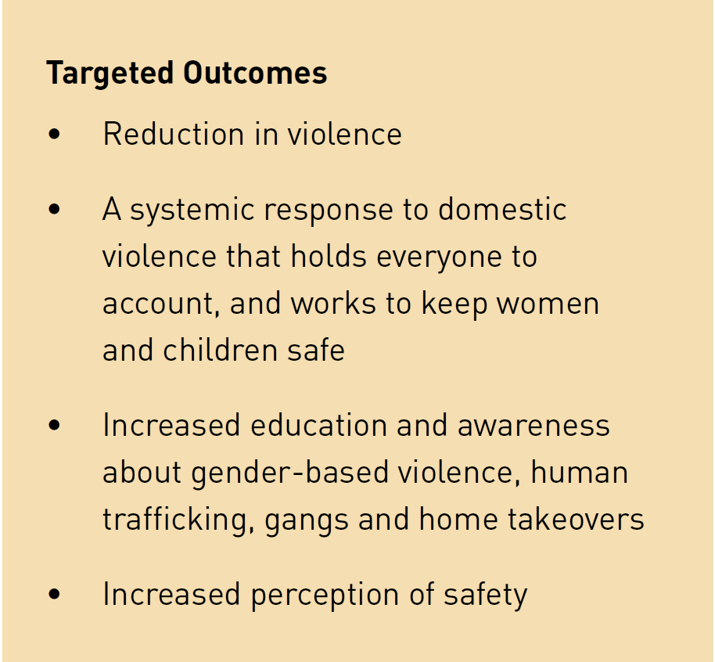
Thunder Bay
Notes:
Abuse more than 10+, Violence, DV

Slide 33

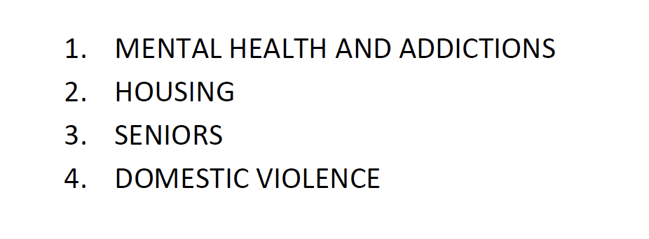
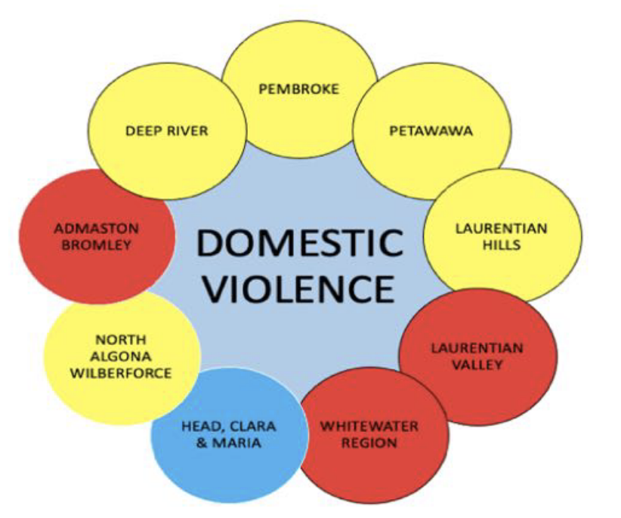
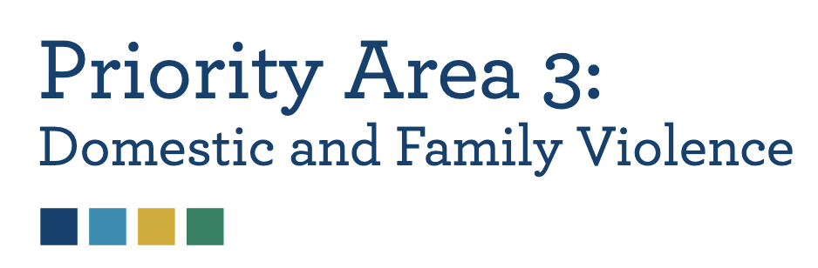
Prince Edward County
Manitoulin
Upper Ottawa Valley
Brockville & Gananoque

Slide 34
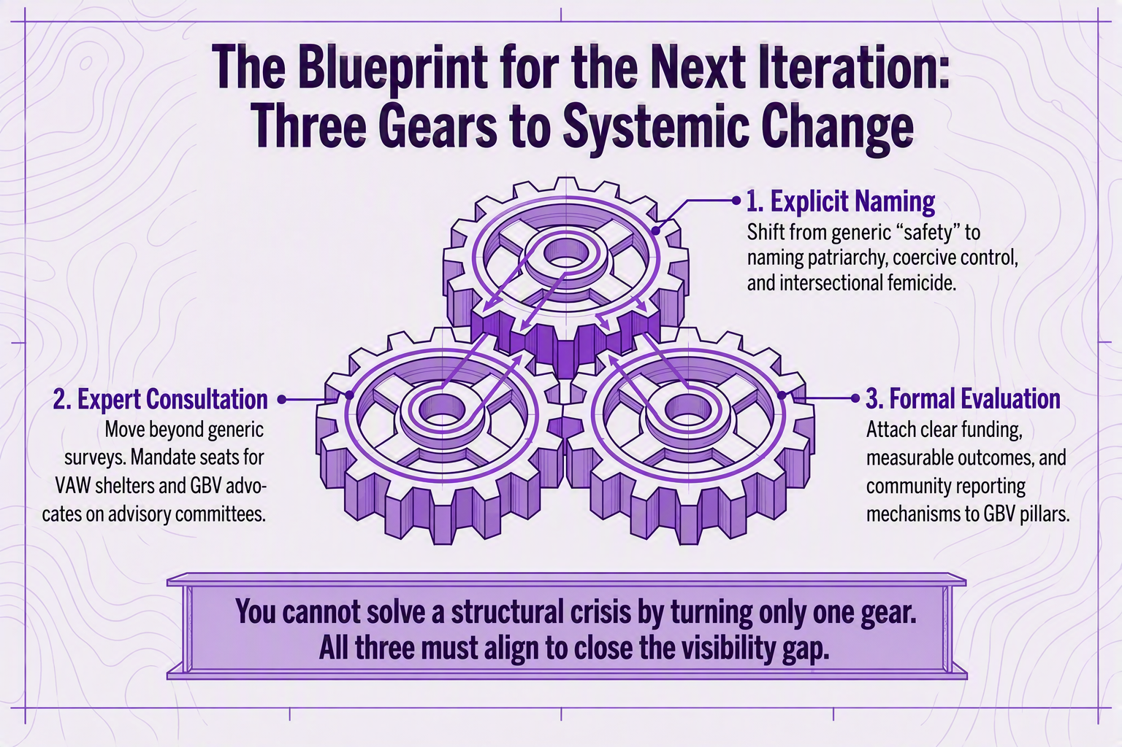

Slide 35
Questions/Comments?

